Slide 1
Cervical Screening Can Save Your Life.

Slide 2
(Workplace) cervical screening session.
Meet your presenters
What is cervical cancer and HPV?
What is the Cervical Screening Program?
How to do the test
Book a test

Slide 3
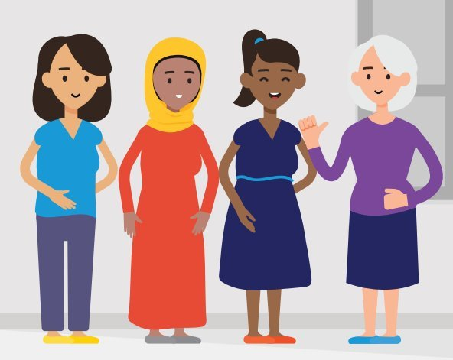
Before we start
(Housekeeping reminders)
(Flag any accessibility inclusions)
Notes:
Cover the length of the session, if they have any questions or if there are accessibility requirements you are adhering to.
Provide an acknowledgement and trigger warning that this presentation will cover difficult topics:
I acknowledge that cancer can be a difficult topic to talk about, and I recognise there may be people in the room today who have personally experienced cancer or supported someone with cancer. Please engage in today’s presentation in a way that makes you feel comfortable, if you need to leave the room to take a break, use the bathroom or get a drink you are welcome to at any time.
If this presentation brings anything up for you, you are welcome to speak with me after the presentation. Or, for private help or information you can
speak to qualified professionals by
calling the Cancer Connect phone
number 13 11 20.

Slide 4
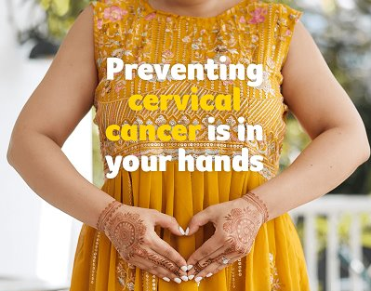
Meet your presenters
Name/s:
This PPT was developed by Cancer Council Victoria as part of their Digital Workplace Toolkit.
Notes:
Introduce yourself
Remind the audience you are not a GP or health care provider (HCP), they should not ask specific health questions.
If you have specific questions related to your health, please speak with your preferred health care provider, at the end of todays presentation I will also let you know where you can find more information.

Slide 5
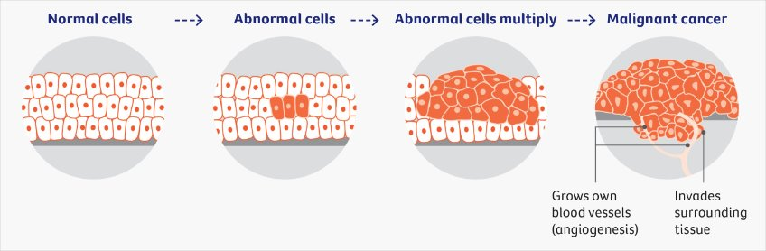
What is cancer?
Notes:
Before we talk about cervical cancer, let’s first understand what cancer is.
Our bodies are made up of millions of tiny building blocks called cells. These cells help our bodies grow, repair themselves and stay healthy.
Normally, cells grow and divide in a controlled way. But sometimes, cells become abnormal and keep growing when they shouldn't. These abnormal cells can form a lump called a tumour.
Not all tumours are cancer. Some are harmless, while others are cancerous and can spread to other parts of the body.
Cancer usually starts in one part of the body. This is called the primary cancer. If cancer cells spread to another part of the body, they can form a new tumour. This is called secondary cancer.
The important thing to remember is that finding cancer early can make it easier to treat and improve a person's chances of survival.
This is why cancer screening is so important. Screening can help find some cancers early, often before a person notices any symptoms. Cervical screening can also find changes in cells before they turn into cancer.

Slide 6
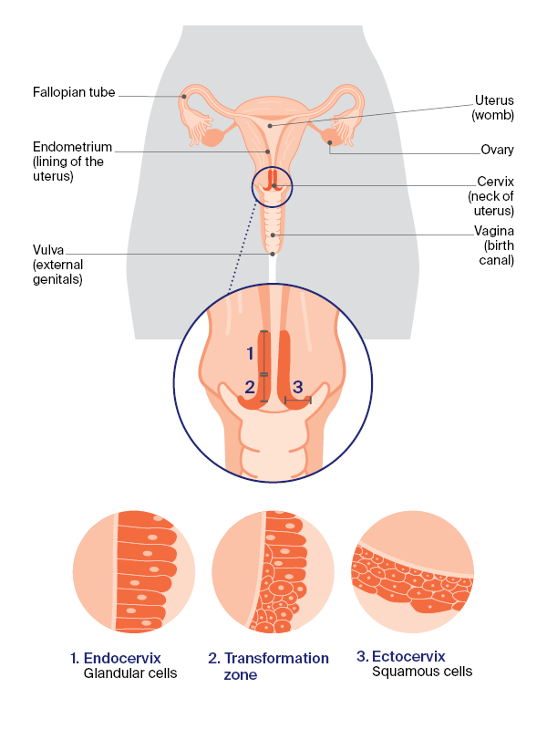
What is cervical cancer?
Image source: About Cervical Cancer | Cancer Council NSW
Notes:
While there are many types of cancers but we are only talking about cervical cancer screening today.
The cervix is the lower part of the uterus that opens into the vagina. The cervix is located between the uterus and vagina and it is not visible from outside of the body.
Cervical cancer is the growth of abnormal cells in the cervix.
Almost all types of cervical cancer are caused by the HPV virus.

Slide 7
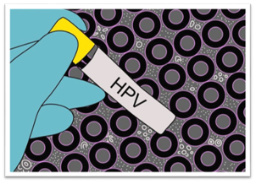
What is human papillomavirus (HPV)?
HPV causes almost all cervical cancers.
HPV is spread by genital-skin to skin contact during sexual activity.
In Australia, there is a free HPV vaccine available for all girls and boys in Year 7 at school.
If you didn't get the vaccine, your doctor can give you this for free up to age 25.
Notes:
HPV is a sexually transmitted infection (a germ that enters the body during sexual activity). This means HPV is passed on by genital skin to skin contact during sexual activity, including penis in vagina sex, oral sex, or same gender sex. Anyone of any gender can get HPV. HPV is a common infection which usually shows no signs or symptoms.
Most HPV infections will go away on their own without causing any problems. Meaning they are cleared by the body’s immune system (the body's natural defenses against germs and sickness, body's ability to fight germs and sickness).
However, if some types of HPV stay in the body for a long time this can cause abnormal cell changes. These abnormal cell changes, if left untreated, may lead to cervical cancer.
If these cell changes are not picked up early they can develop into cervical cancer, it usually takes many years for this to happen.
In Australia, we are lucky to have the HPV vaccination program which means you have a much smaller chance of developing
Cervical cancer
Other cancers of the anus, vagina, vulva ,penis, throat
Genital warts
While the vaccine can reduce your risk, it doesn't eliminate it, which is why it is important to still get have regular cervical screening when due.

Slide 8
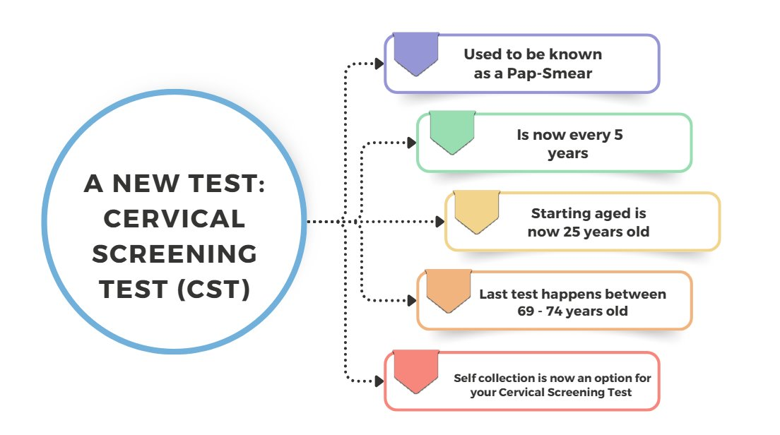
The National Cervical Screening Program
Notes:
In Australia, we are very lucky to have a free national cervical screening program that looks for signs of cervical cancer before symptoms occur. This is called the National Cervical Screening Program.
Since 2017 there have been changes to the National Cervical Screening Program in Australia:
New test (change from Pap Test to Cervical Screening Test or CST)
Screening interval (test done every 5 years, instead of 2)
Screening age (Starting age is from 25 instead of 18 and exit test between 70-74)
Women will receive an invitation to screen from the National Cancer Screening Register after their 25th birthday

Slide 9
How to do the test

Slide 10
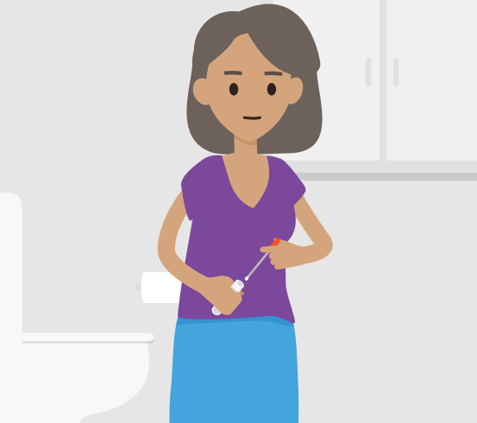

Cervical Screening Test options
Women and people with a cervix can choose how they want to have their Cervical Screening Test. They can:
Collect their own vaginal sample (self-collection) using a swab or
Have a healthcare provider collect a sample (clinician collected) using a speculum and small brush.
Self-collection swab
Speculum
Notes:
You have options for your Cervical Screening Test, this includes collecting your own sample or having your doctor or specially trained nurse collect a sample using a speculum.
It is your body and your choice where and how you screen.
However its important to remember that you still need to book an appointment with a health professional such as a Doctor, Nurse or Aboriginal Health Practitioner for both screening options.

Slide 11
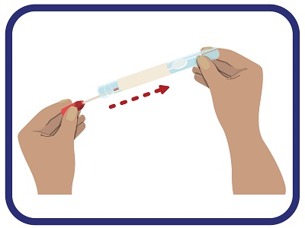
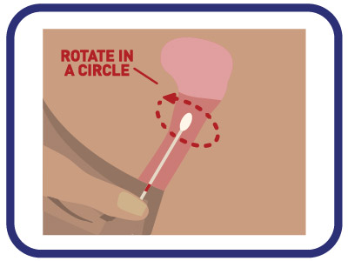
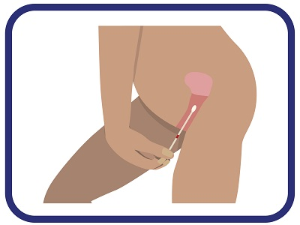
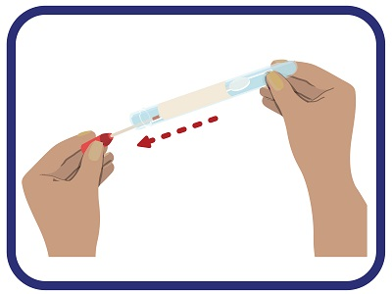
How to do the self-collection test in 4 simple steps
Step 1
  Wash your hands
  Twist the cap off the tube and pull out the swab
  Look at the swab and note the mark closest to the tip
Step 2
  Get in a comfortable position
  Insert the swab into your vagina, aiming to insert to the mark
  Tip: It may be easier to use your other hand to hold the outer skin at the entrance of your vagina
Step 3
  Rotate the swab gently 2-3 times, for about 10 seconds
  It should not hurt
Step 4
  Remove the swab and place back in the tube
  Return the tube to your doctor or nurse
Notes:
If you chose the self-collection option you will be given a test tube with a swab at your health care clinic.
You can go into a private space, and follow these four easy steps to collect your own sample. Your doctor can go through this with you and give you some information to help you do this test. In some instances, your doctor or specially trained nurse can also help you to collect your sample using this test.
In the next slide we will compare this test to the clinician collected test using a speculum, however it is important to remember both are accurate and safe options for cervical screening.

Slide 12
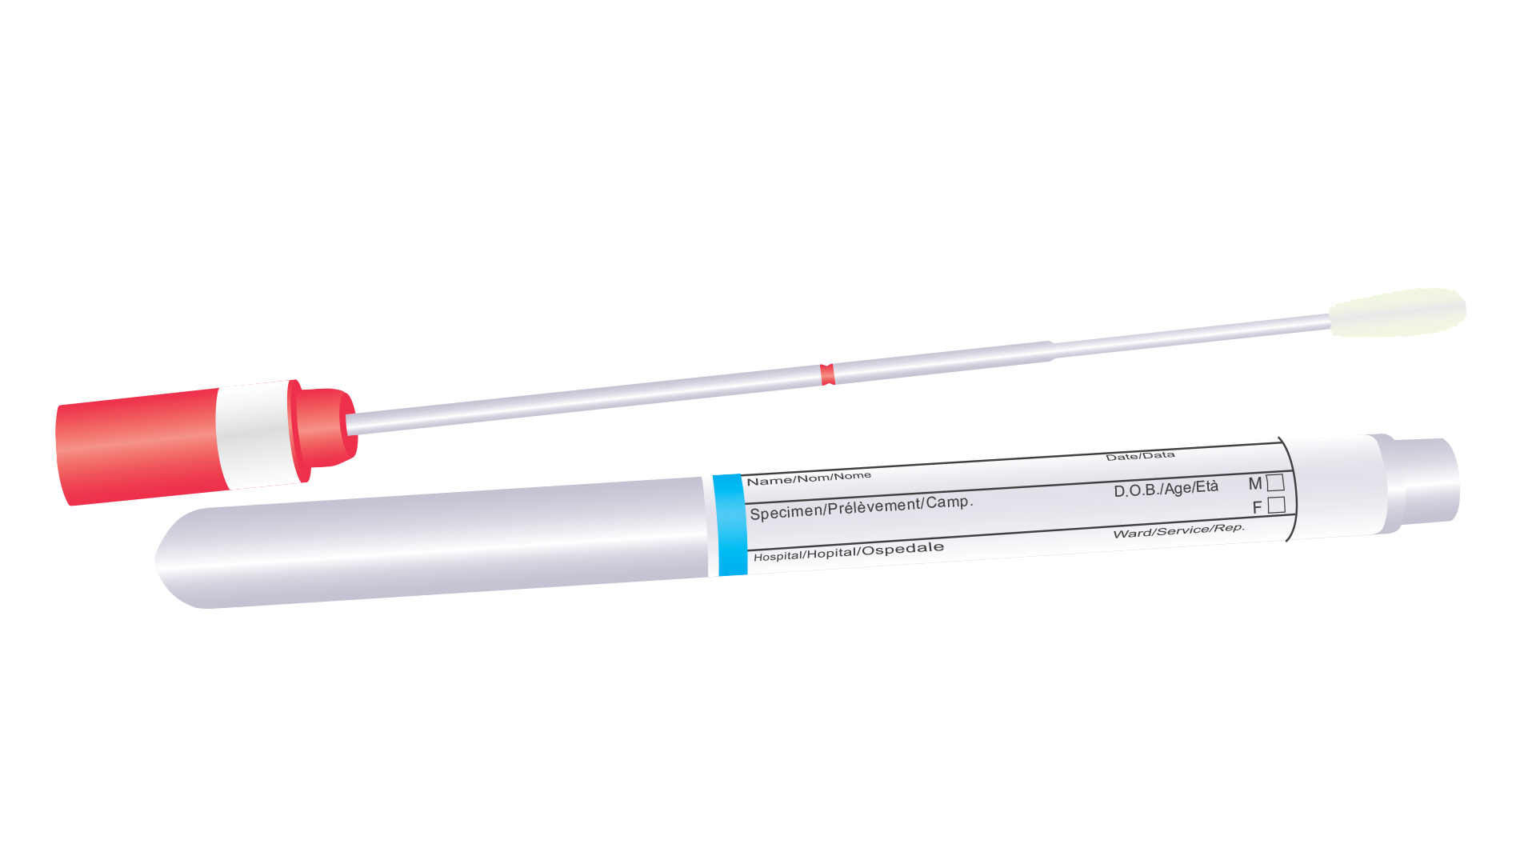

Cervical Screening Test options
 | Self-collected sample | Clinician-collected sample
Tool used | Self-collection swab | Speculum and brush
Who collects the test sample? | You do it yourself or a doctor or Nurse Cervical Screening Provider can take the test for you if you want. | A doctor or Nurse Cervical Screening Provider.
Where is the sample taken from? | The vagina. | The cervix.
What does it look for? | The presence of HPV. | The presence of HPV.
Where is the test usually done? | In a private space within a healthcare setting (e.g. behind a curtain or screen or in the bathroom). In some cases your doctor may be able to support you doing the test at home. | On an examination bed in a doctor’s office.
Is it accurate in detecting HPV? | Yes | Yes
How often do I need to do this?* | Every 5 years | Every 5 years
Is it safe during pregnancy? | Yes | Yes
Notes:
This table shows you the differences between the two options.
As previously mentioned both are accurate and safe options in protecting your health against cervical cancer.

Slide 13
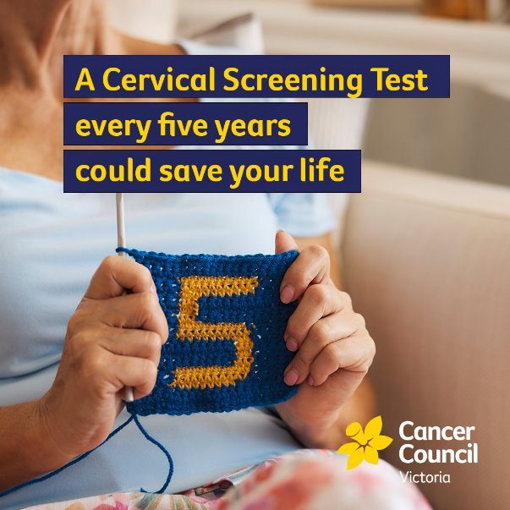
Who is eligible?
You need to do cervical screening if you are
  Aged 25 – 74, and
  Have a cervix, and
  Have ever had any kind of sex.
Must have a Medicare card (green or blue).
If you are eligible, you will receive an SMS or letter reminding you to book in the test every 5 years. Individuals will need to book an appointment yourself at a health clinic and ask for the test.
Notes:
Starting at age 25 is safe – the changes in guidelines are based on a lot of evidence and new technology.
Cervical cancer in women below the age of 25 is extremely rare
The HPV vaccine means more people are protected from HPV
It can take more than a decade for HPV infection to develop into cervical cancer

Slide 14
Questions we are asked
Do I still need to do the test if I have had the HPV vaccine? Yes
I have only had sex a few times, or many years ago. Do I still need the test? Yes
Can I have the Cervical Screening Test while pregnant? Yes, either test option is still safe
I've had my uterus removed (hysterectomy) do I still need a test? Often yes – ask your doctor
Notes:
Even if you feel fit and healthy, it is important to participate in cervical screening when you are due, as often there are no symptoms for cervical cancer.
These common misconceptions sometimes means people will put off cervical screening. Remember your doctor wants to see you to help you protect yourself against cervical cancer so you can be there for yourself and your family.

Slide 15
What does my test result mean?
Test result | What does it mean? | What you should do
HPV not detected | No HPV found | This is good news. Repeat the test in 5 years. Talk to your doctor if you develop any symptoms of cervical cancer before 5 years.
HPV detected | HPV has been found | You do not necessarily have cancer, but you do have HPV. Further testing with your doctor is needed.
Unsatisfactory | Result is unclear | The laboratory can’t read your sample. You will need to do the test again.
Notes:
There are a few different outcomes once you have done your Cervical Screening Test.
In most cases, you will not find HPV and you can have peace of mind against cervical cancer and go back in 5 years time.
If HPV is detected, your doctor will help you with the next steps.

Slide 16
How to book a test

Slide 17

Book your next Cervical Screening Test
Book a test with your doctor
Use Cancer Council Victoria's Screening Directory
Telehealth options are now available
Scan this QR code to visit the CCV Screening Directory website and find a healthcare professional near you
Notes:
We hope this presentation has made you feel more comfortable with cervical screening and want to check if you are eligible and due for your next screen.
We can support you to book an appointment, or you can call your doctors office, book using Cancer Council Victoria's free cervical screening directory.

Slide 18



Where can I get more information?
Visit the Cancer Council Victoria website – Scan the QR code for information on cervical cancer and screening
For private help or information, you can speak to qualified professionals by calling or emailing the Cancer Council support service Cancer Connect.
Call 13 11 20
For a free interpreter call 13 14 50
Email askanurse@cancervic.org.au
Request a call back cancervic.org.au/get-support

Slide 19
Thank you.

